Slide 1
Data structures and algorithms - Fundamentals

Slide 2
Data Structures and Algorithms – Definitions
In the most general sense, a data structure is any data representation and its
associated operations. Even an integer or floating point number stored on the computer can be viewed as a simple data structure.
In computer science, a data structure is a particular way of organizing data in a computer so that it can be used efficiently.* Data structures can implement one or more particular Abstract Data Types (ADT)
Usually, efficient data structures are key to designing efficient algorithms
Notes:
* - Entry data structure in the Encyclopedia Britannica

Slide 3
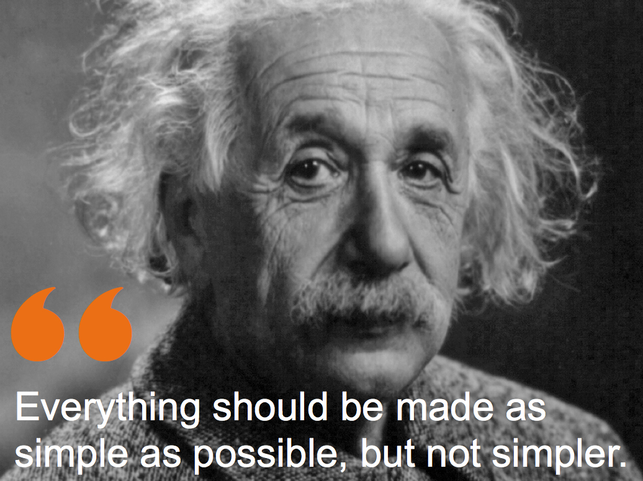
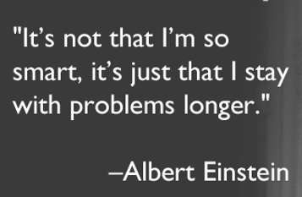
Data Structures and Algorithms

Slide 4
Data Structures and Algorithms
Each data structure and each algorithm has costs and benefits. Practitioners
need a thorough understanding of how to assess costs and benefits to be able
to adapt to new design challenges. This requires an understanding of the
principles of algorithm analysis, and also an appreciation for the significant
effects of the physical medium employed (e.g., data stored on disk versus
main memory).
Related to costs and benefits is the notion of tradeoffs. For example, it is quite
common to reduce time requirements at the expense of an increase in space
requirements, or vice versa. Programmers face tradeoff issues regularly during the phases of software design and implementation, so the concept must become
deeply ingrained.
Programmers should know enough about common practice to avoid reinventing
the wheel. Thus, programmers need to learn the commonly used
data structures, their related algorithms, and the most frequently encountered
design patterns found in programming.
Data structures follow needs. Programmers must learn to assess application
needs first, then find a data structure with matching capabilities.

Slide 5
Fundamental Data Structures
Array/ Dynamic Array
List / Stack and Queue
Tree – binary Trees
Non Binary Trees
Graphs

Slide 6
Basic data structures - Array
Definition: Contiguous block of memory locations, where each memory location stores one fixed-length data item. It could also mean a logical data type composed of a (typically homogeneous) collection of data items, with each data item identified by an index number:
collection of elements of similar datatype
contiguous memory allocation
each element can be accessed directly using position variable
array elements can be accessed individually
0
1
2
N
…
size
size
size
size
Problems with an array:
Array size is fixed
Unsorted array: searching for an item is slow
Sorted array: insertion and deletion is slow

Slide 7
Basic data structures - Array
Examples:
tables, especially lookup table - replaces runtime computation with a simpler array indexing operation.
The savings in terms of processing time can be significant, since retrieving a value from memory is often faster than undergoing an 'expensive' computation.

Slide 8

Basic data structures – List
Definition: Finite, ordered sequence of data items known as elements. “Ordered” in this definition means that each element has a position in the list.
For simplicity all elements of the list should have the same data type
There is no conceptual objection to lists whose elements have differing
data types if the application requires it.
The operations defined as part of the list ADT do not depend on the elemental data type.
Definition: A list is said to be empty when it contains no elements.
Definition: The number of elements currently stored is called the length of the list.
Definition: The beginning of the list is called the head, the end of the list is called the tail.

Slide 9
Basic data structures – List
A program designer should first consider what basic operations the implementation must support. Our common intuition about lists tells us that a list should be able to:
grow and shrink in size as we insert and remove elements.
to insert and remove elements from anywhere in the list.
to gain access to any element’s value, either to read it or to change it.
to create and clear (or reinitialize) lists.
to access the next or previous element from the “current” one.

Slide 10
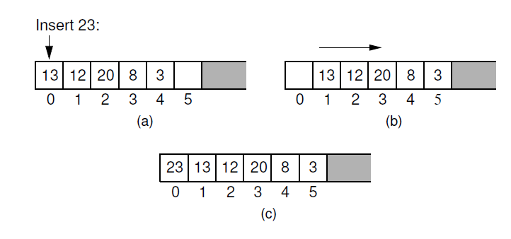
Basic data structures – Array based List
There are two standard approaches to implementing lists, the array-based list, and the linked list.
Inserting an element at the head of an array-based list requires shifting
all existing elements in the array by one position toward the tail:
A list containing five elements before inserting an element with value 23.
The list after shifting all existing elements one position to the right.
The list after 23 has been inserted in array position 0.

Slide 11
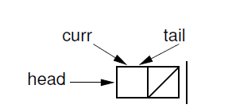
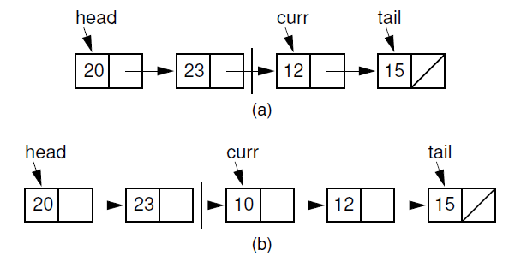
Basic data structures – Linked List
The second traditional approach to implementing lists makes use of pointers and is
usually called a linked list. The linked list uses dynamic memory allocation
Initial state of a linked list when using a header node
Linked list prior to inserting element with value 10.
(b) Desired effect of inserting element with value 10.

Slide 12
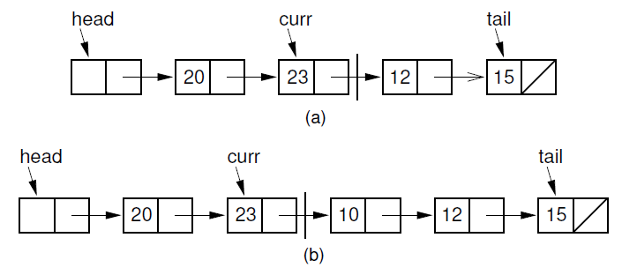
Basic data structures – Linked List
A key design decision for the linked list implementation is how to represent the current position. The most reasonable choices appear to be a pointer to the current element. But there is a big advantage to making curr point to the element preceding the current element.
(a) Linked list before insertion. The current node contains 12.
(b) Linked list after inserting the node containing 10.

Slide 13
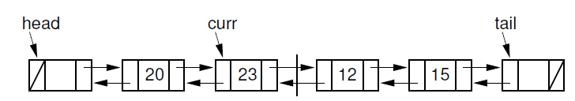
Basic data structures – List
Doubly Linked Lists
Rule: A doubly linked list allows convenient access from a list node to the next node and also to the preceding node on the list.

Slide 14
Basic data structures – Stack
Definition: List-like structure in which elements may be inserted or removed
from only one end.
Rule: While this restriction makes stacks less flexible than lists, it
also makes stacks both efficient and easy to implement.
AKA: “LIFO” list, which stands for “Last-In, First-Out”
100
87
87
87
20
20
20
15
15
15
12
12
12
7
7
7
Original contents
Pop
Push

Slide 15
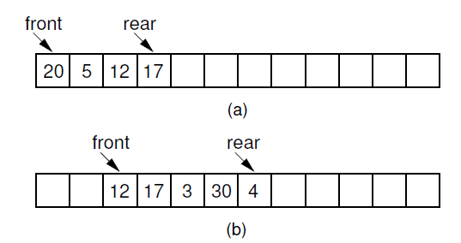
Basic data structures – Queue
Definition: List-like structure that provides restricted access to
its elements.
Rule: Queue elements may only be inserted at the back and removed from the front.
AKA: “FIFO” list, which stands for “First-In, First-Out.
(a) The queue after the initial four numbers 20, 5, 12, and 17 have been inserted.
(b) The queue after elements 20 and 5 are deleted, following
which 3, 30, and 4 are inserted.

Slide 16
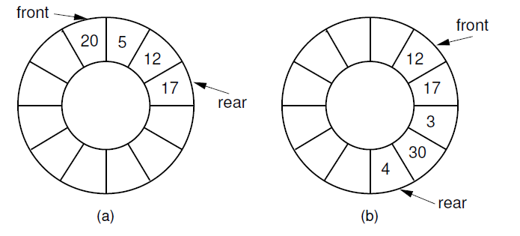
Basic data structures – Queue
(a) The queue after the initial four numbers 20, 5, 12, and 17 have been inserted.
(b) The queue after elements 20 and 5 are deleted, following which 3,
30, and 4 are inserted.

Slide 17
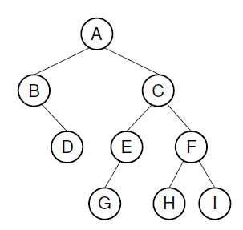
Basic data structures - Trees
Rule: The list representations have a fundamental limitation: Either search or insert can be made efficient, but not both at the same time. Tree structures permit both efficient access and update to large collections of data.
Example: Binary trees are useful for many things besides searching - trees can speed up prioritizing jobs, describing mathematical expressions and the syntactic elements of computer programs, or organizing the information needed to drive data compression algorithms.
Root (level 0)
Child of A
Child of A
Leaves
Leaves

Slide 18
Basic data structures – Binary Trees
Definition: A binary tree is made up of a finite set of elements called nodes.
Rule: This set either is empty or consists of a node called the root together with two binary trees, called the left and right subtrees, which are disjoint from each other and from the root (Disjoint means that they have no nodes in common).
Definition: The roots of these subtrees are children of the root.
Definition: There is an edge from a node to each of its children, and
a node is said to be the parent of its children.
Rule: If n₁, n₂, ..., n_{k} is a sequence of nodes in the tree such that n_{i} is the parent of
n_{i}+1 for 1 < i < k, then this sequence is called a path from n₁ to n_{k}. The length
of the path is k-1.
Rule: All nodes in the tree are descendants of the root of the tree, while the root is the ancestor of all nodes.
Definition: The depth of a node M in the tree is the length of the path from the root of the tree to M.

Slide 19
Basic data structures – Binary Trees
Definition: The height of a tree is one more than the depth of the deepest node in the tree. All nodes of depth d are at level d in the tree. The root is the only node at level 0, and its depth is 0.
Definition: A leaf node is any node that has two empty children.
Definition: An internal node is any node that has at least one non-empty child.

Slide 20
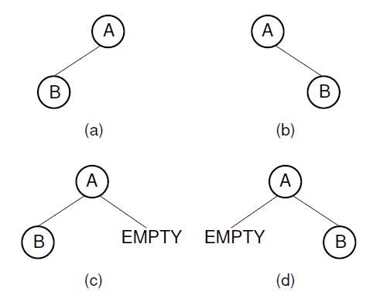
Basic data structures - Trees
Two different binary trees. (a) A binary tree whose root has a nonempty
left child. (b) A binary tree whose root has a non-empty right child. (c) The
binary tree of (a) with the missing right child made explicit. (d) The binary tree
of (b) with the missing left child made explicit.

Slide 21
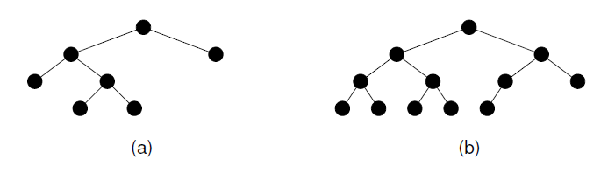
Basic data structures - Trees
This tree is full (but not complete).
This tree is complete (but not full).
Rule: Two restricted forms of binary tree are sufficiently important to warrant special
names:
each node in a full binary tree is either an internal node with exactly
two non-empty children or a leaf
a complete binary tree has a restricted shape obtained by starting at the root and filling the tree by levels from left to right
In the complete binary tree of height d, all levels except possibly level d-1 are completely full. The bottom level has its nodes filled in from the left side

Slide 22
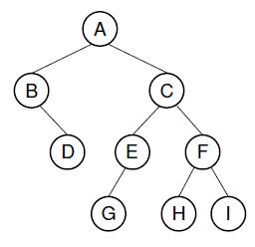
Basic data structures – Binary Tree Traversal
Definition: Any process for visiting all of the nodes in some order is called a traversal. Any traversal that lists every node in the tree exactly once is called an enumeration of the tree’s nodes.
Definition: We might wish to make sure that we visit any given node before we visit its children. This is called a preorder traversal.
The preorder enumeration for the tree is ABDCEGFHI:
The first node printed is the root. Then all nodes of the left subtree are
printed (in preorder) before any node of the right subtree.

Slide 23
Basic data structures – Binary Tree Traversal
Definition: Alternatively, we might wish to visit each node only after we visit its children (and their subtrees). We would like to delete the children of a node
before deleting the node itself. This is called a postorder traversal.
The postorder enumeration is: DBGEHIFCA:
Definition: An inorder traversal first visits the left child (including its entire subtree), then visits the node, and finally visits the right child (including its entire subtree).
The inorder enumeration is:
BDAGECHFI:

Slide 24
Basic data structures – Non Binary Trees
Major Definition: A tree T is a finite set of one or more nodes such that there is one designated node R, called the root of T. If the set (T-{R}) is not empty, these nodes are partitioned into n > 0 disjoint subsets T0, T1, ..., Tn-1, each of which is a tree, and whose roots R1, R2, ..., Rn, respectively, are children of R. The subsets Ti (0 < i < n) are said to be subtrees of T.
Major Rules: These subtrees are ordered in that Ti is said to come before Tj if i < j. By convention, the subtrees are arranged from left to right with subtree T0 called the leftmost child of R.
Definition: A node’s out degree is the number of children for that node. A forest is a collection of one or more trees.
Rule: Each node in a tree has precisely one parent, except for the root, which has no parent. From this observation, it immediately follows that a tree with n nodes must have n -1 edges because each node, aside from the root, has one edge connecting that node to its parent.

Slide 25
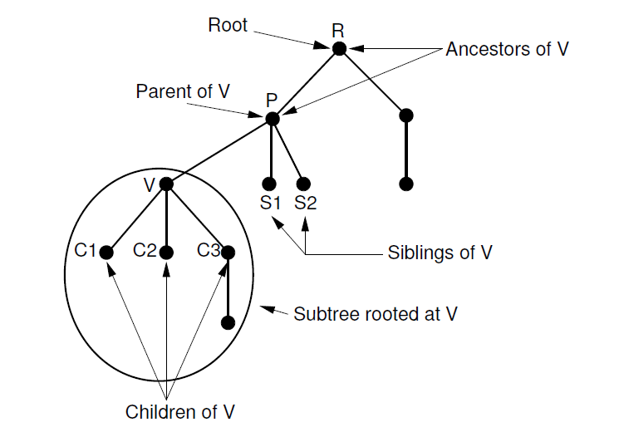
Basic data structures - Trees
Notation for general trees. Node P is the parent of nodes V, S1,
and S2. Thus, V, S1, and S2 are children of P. Nodes R and P are ancestors of V.
Nodes V, S1, and S2 are called siblings. The oval surrounds the subtree having V
as its root.

Slide 26
Basic data structures – Graphs
Rules: Graphs provide the ultimate in data structure flexibility. Graphs can model both real-world systems and abstract problems, so they are used in hundreds of applications.
Here is a small sampling of the range of problems that graphs are routinely
applied to.
1. Modeling connectivity in computer and communications networks.
2. Representing a map as a set of locations with distances between locations;
used to compute shortest routes between locations.
3. Modeling flow capacities in transportation networks.
4. Finding a path from a starting condition to a goal condition; for example, in
artificial intelligence problem solving.
5. Modeling computer algorithms, showing transitions from one program state
to another.
6. Finding an acceptable order for finishing subtasks in a complex activity, such
as constructing large buildings.
7. Modeling relationships such as family trees, business or military organizations,
and scientific taxonomies.

Slide 27
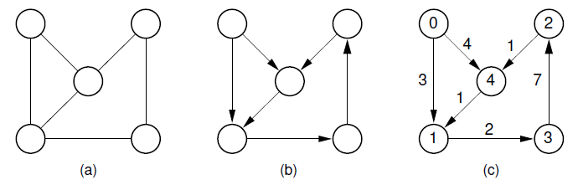
Basic data structures – Graphs
Examples of graphs and terminology: (a) A graph. (b) A directed graph (digraph).
(c) A labeled (directed) graph with weights associated with the edges. In this example, there is a simple path from Vertex 0 to Vertex 3 containing Vertices 0, 1, and 3. Vertices 0, 1, 3, 2, 4, and 1 also form a path, but not a simple path because Vertex 1 appears twice. Vertices 1, 3, 2, 4, and 1 form a simple cycle.

Slide 28
Basic data structures – Graphs
Major Definitions: A graph G = (V;E) consists of a set of vertices V and a set of edges E, such that each edge in E is a connection between a pair of vertices in V.
The number of vertices is written |V|, and the number of edges is written |E|. |E| can range from zero to a maximum of |V|² -|V|. A graph with relatively few edges is called sparse, while a graph with many edges is called dense. A graph containing all possible edges is said to be complete.
A graph with edges directed from one vertex to another is called a directed graph or digraph. A graph whose edges are not directed is called an undirected graph.
A graph with labels associated with its vertices is called a labeled graph.
Two vertices are adjacent if they are joined by an edge. Such vertices are also called neighbors.
An edge connecting Vertices U and V is written (U, V). Such an edge is said to be incident on Vertices U and V. Associated with each edge may be a cost or weight.
Graphs whose edges have weights are said to be weighted.

Slide 29
Basic data structures – Graphs
A sequence of vertices v1, v2, ..., vn forms a path of length n -1 if there exist edges from vi to vi+1 for 1 < i < n.
A path is simple if all vertices on the path are distinct. The length of a path is the number of edges it contains.
A cycle is a path of length three or more that connects some vertex v1 to itself. A cycle is simple if the path is simple, except for the first and last vertices being the same.

Slide 30
Basic data structures – Graph Traversals
Often it is useful to visit the vertices of a graph in some specific order based on the graph’s topology:
Definition:. This is known as a graph traversal and is similar in concept to a tree traversal. Recall that tree traversals visit every node exactly once, in some specified order such as preorder, inorder, or postorder.
Rule: Graph traversal algorithms typically begin with a start vertex and attempt to
visit the remaining vertices from there.
Edge case: It may not be possible to reach all vertices from the start vertex. This occurs when the graph is not connected.
Edge case: The graph may contain cycles, and we must make sure that cycles do not cause the algorithm to go into an infinite loop.

Slide 31
Basic data structures – Graph Traversals
Rule: Graph traversal algorithms can solve both of these problems by maintaining a mark bit for each vertex on the graph. At the beginning of the algorithm, the mark bit for all vertices is cleared. The mark bit for a vertex is set when the vertex is first visited during the traversal. If a marked vertex is encountered during traversal, it is not visited a second time. This keeps the program from going into an infinite loop when it encounters a cycle.
Rule: Once the traversal algorithm completes, we can check to see if all vertices have been processed by checking the mark bit array. If not all vertices are marked, we can continue the traversal from another unmarked vertex.

Slide 32
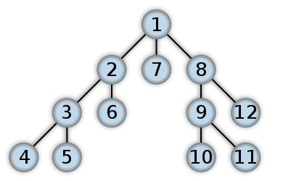
Basic data structures – Graph Traversals
Depth-First Search (DFS) and Breadth-First Search (BFS)
Definition: The first method of organized graph traversal is called depth-first search (DFS).
Whenever a vertex V is visited during the search, DFS will recursively visit all
of V’s unvisited neighbors. Equivalently, DFS will add all edges leading out of v
to a stack. The next vertex to be visited is determined by popping the stack and
following that edge.
The effect is to follow one branch through the graph to its conclusion, then it will back up and follow another branch, and so on.

Slide 33
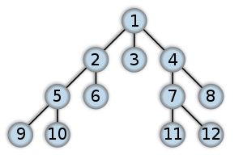
Basic data structures – Graph Traversals
Definition: The second graph traversal algorithm is known as a breadth-first search (BFS).
BFS examines all vertices connected to the start vertex before visiting vertices further away.
BFS is implemented similarly to DFS, except that a queue replaces
the recursion stack.
Note that if the graph is a tree and the start vertex is at the
root, BFS is equivalent to visiting vertices level by level from top to bottom

Slide 34
Basic data structures – Graph Traversals
Shortest-Paths Problem
On a road map, a road connecting two towns is typically labeled with its distance.
We can model a road network as a directed graph whose edges are labeled with
real numbers. These numbers represent the distance (or other cost metric, such as
travel time) between two vertices. These labels may be called weights, costs, or
distances, depending on the application. Given such a graph, a typical problem
is to find the total length of the shortest path between two specified vertices. This
is not a trivial problem, because the shortest path may not be along the edge (if
any) connecting two vertices, but rather may be along a path involving one or more
intermediate vertices.

Slide 35
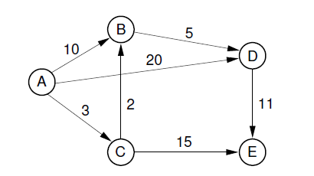
Basic data structures – Graphs
Example graph for shortest-path definitions

Slide 36

www.visteon.com

Slide 37
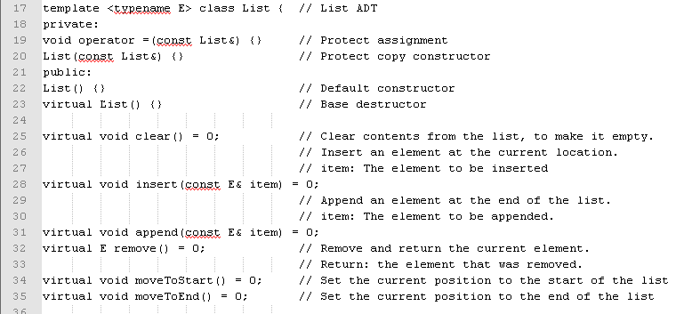
Basic data structures – List
ADT for a list object in terms of a set of operations on that object

Slide 38
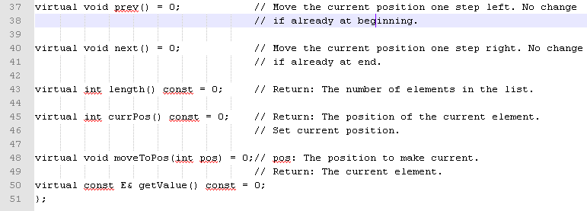
Basic data structures – List
Notes:
Class List defines the member functions that any list implementation
inheriting from it must support, along with their parameters and return types.
We increase the flexibility of the list ADT by writing it as a C++ template.
True to the notion of an ADT, anabstract class does not specify how operations
are implemented. Two complete implementations are presented later in this section,
both of which use the same list ADT to define their operations, but they are
considerably different in approaches and in their space/time tradeoffs.
Figure 4.1 presents our list ADT. Class List is a template of one parameter,
named E for “element”. E serves as a placeholder for whatever element type the
user would like to store in a list. The comments given in Figure 4.1 describe precisely
what each member function is intended to do. However, some explanation
of the basic design is in order. Given that we wish to support the concept of a sequence,
with access to any position in the list, the need for many of the member
functions such as insert and moveToPos is clear. The key design decision embodied
in this ADT is support for the concept of a current position. For example,
member moveToStart sets the current position to be the first element on the list,
while methods next and prev move the current position to the next and previous
elements, respectively. The intention is that any implementation for this ADT
support the concept of a current position. The current position is where any action
such as insertion or deletion will take place.
Since insertions take place at the current position, and since we want to be able
to insert to the front or the back of the list as well as anywhere in between, there are
actually n + 1 possible “current positions” when there are n elements in the list.
It is helpful to modify our list display notation to show the position of the
current element. I will use a vertical bar, such as h20; 23 j 12; 15i to indicate
the list of four elements, with the current position being to the right of the bar at
element 12. Given this configuration, calling insert with value 10 will change
the list to be h20; 23 j 10; 12; 15i.
If you examine Figure 4.1, you should find that the list member functions provided
allow you to build a list with elements in any desired order, and to access
any desired position in the list. You might notice that the clear method is not
necessary, in that it could be implemented by means of the other member functions
in the same asymptotic time. It is included merely for convenience.
Method getValue returns a pointer to the current element. It is considered a
violation of getValue’s preconditions to ask for the value of a non-existent element
(i.e., there must be something to the right of the vertical bar). In our concrete
list implementations, assertions are used to enforce such preconditions. In a commercial
implementation, such violations would be best implemented by the C++
exception mechanism.

Slide 39
Basic data structures – List
As an example of using the list ADT, we can create a function to return true if there is an occurrence of a given integer in the list, and false otherwise. The find method needs no knowledge about the specific list implementation, just the list ADT.
// Return true if "K" is in list "L", false otherwise
bool find(List<int>& L, int K) {
int it;
for (L.moveToStart(); L.currPos()<L.length(); L.next()) {
it = L.getValue();
if (K == it) return true; // Found K
}
return false; // K not found
}

Slide 40
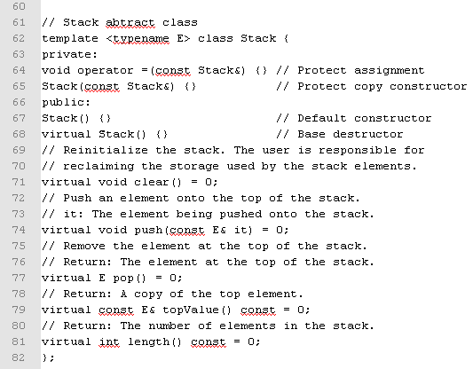
Basic data structures – Stack

Slide 41
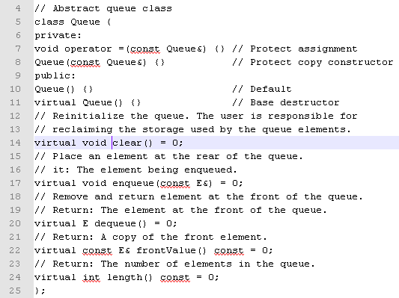
Basic data structures – Queue

